Slide 1
DOMUS - INSULA - VILLA
http://www.purposegames.com/game/villa-romana-quiz
http://www.ancientvine.com/houseofthevine.html
https://www.youtube.com/watch?v=gDiqKUzSeZM

Slide 2
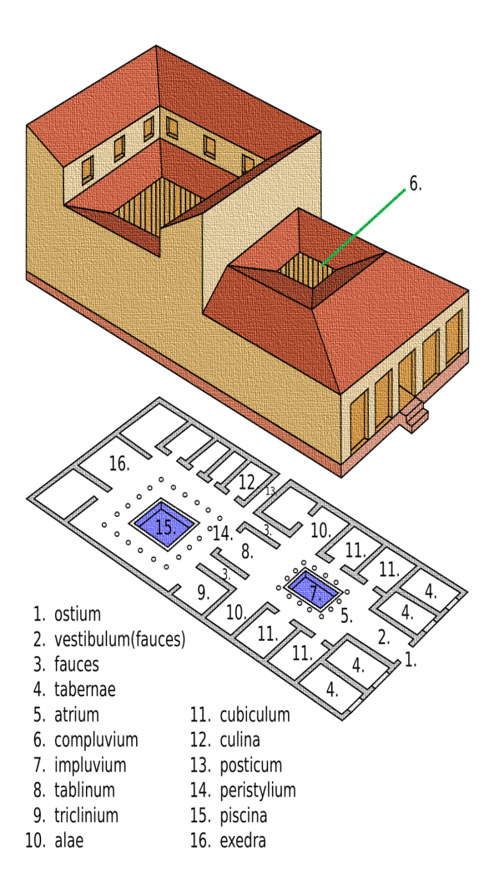
DOMUS

Slide 3
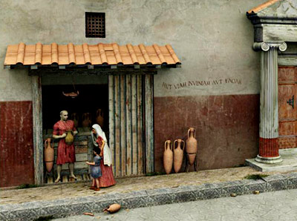
TABERNA

Slide 4
VESTIBULUM

Slide 5
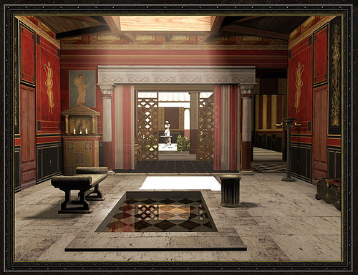
ATRIUM
compluvium
lararium
impluvium

Slide 6
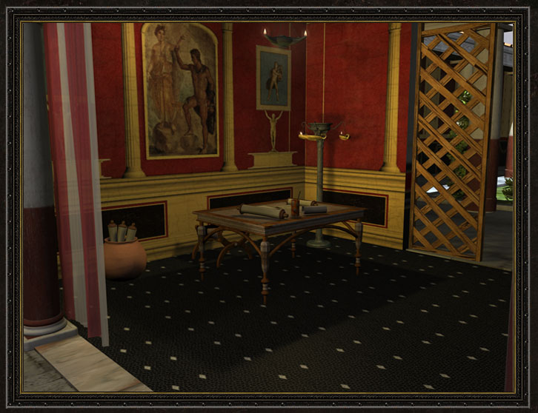
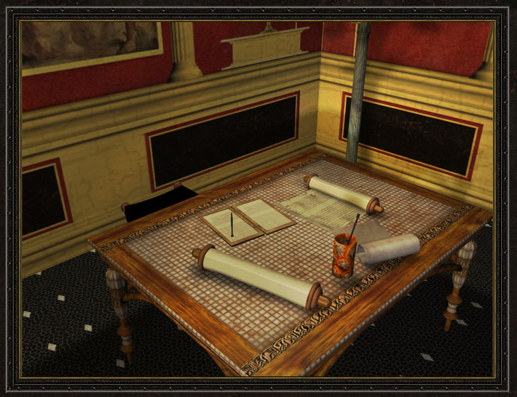
TABLINUM

Slide 7
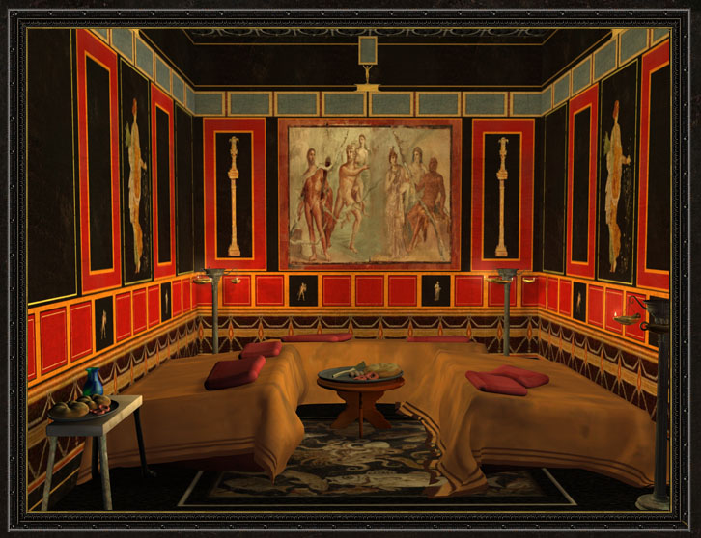
TRICLINIUM

Slide 8
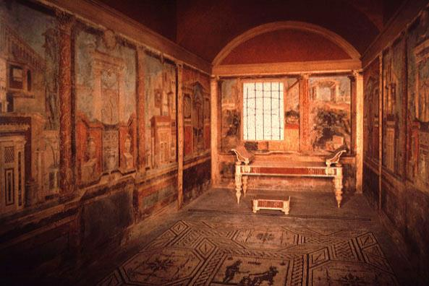
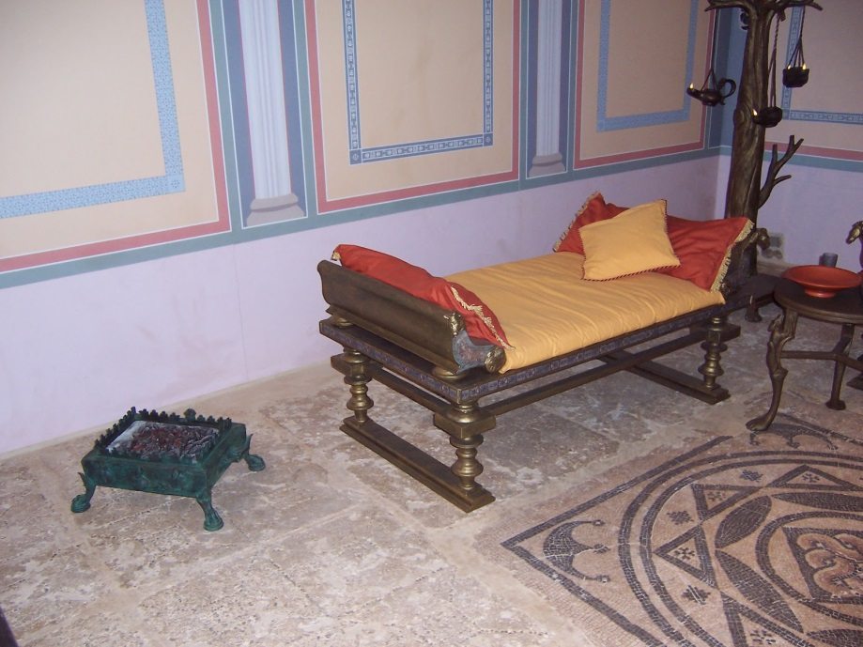
CUBICULUM

Slide 9
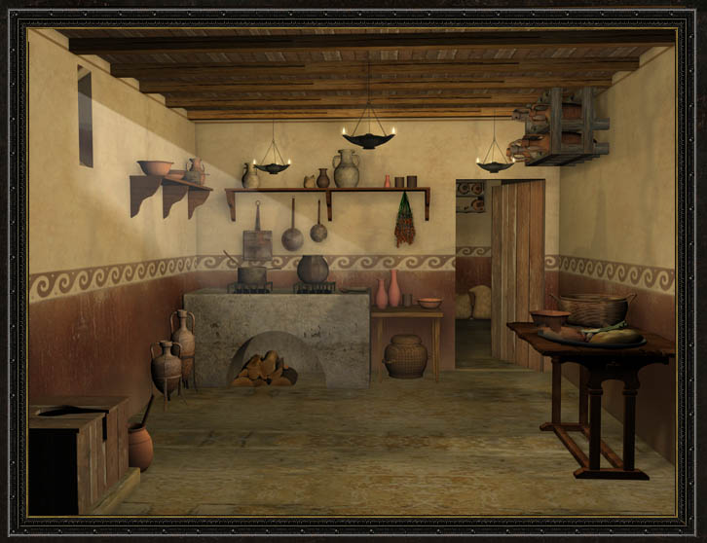
CULINA

Slide 10
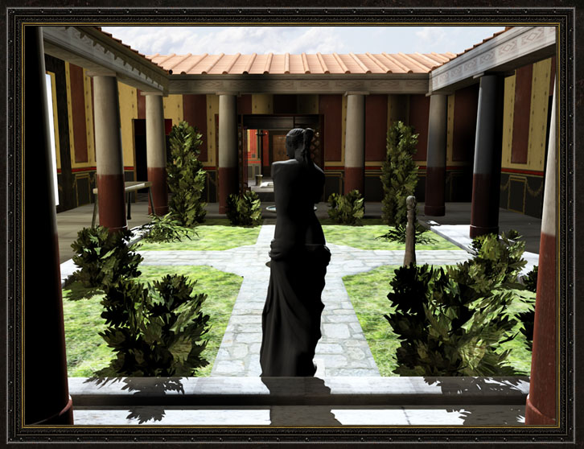
PERISTYLUM

Slide 11
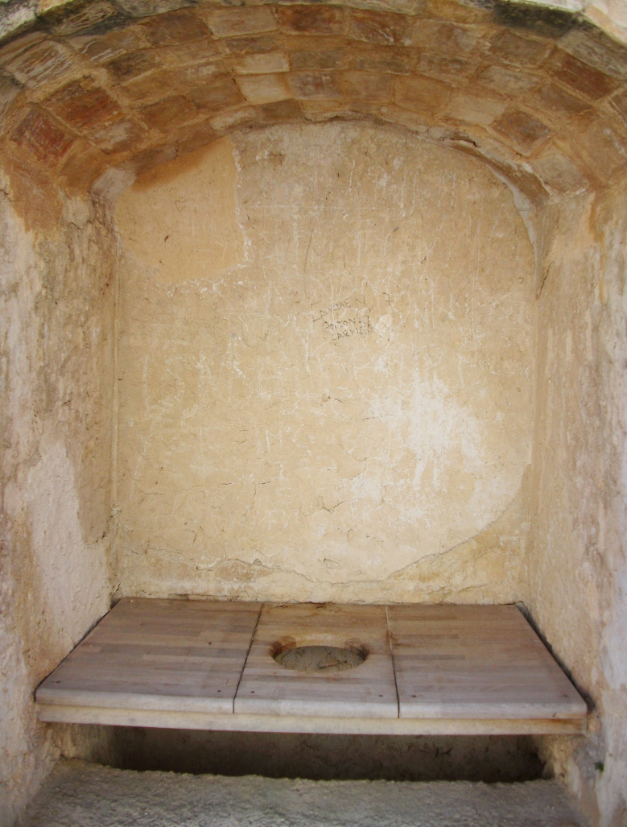
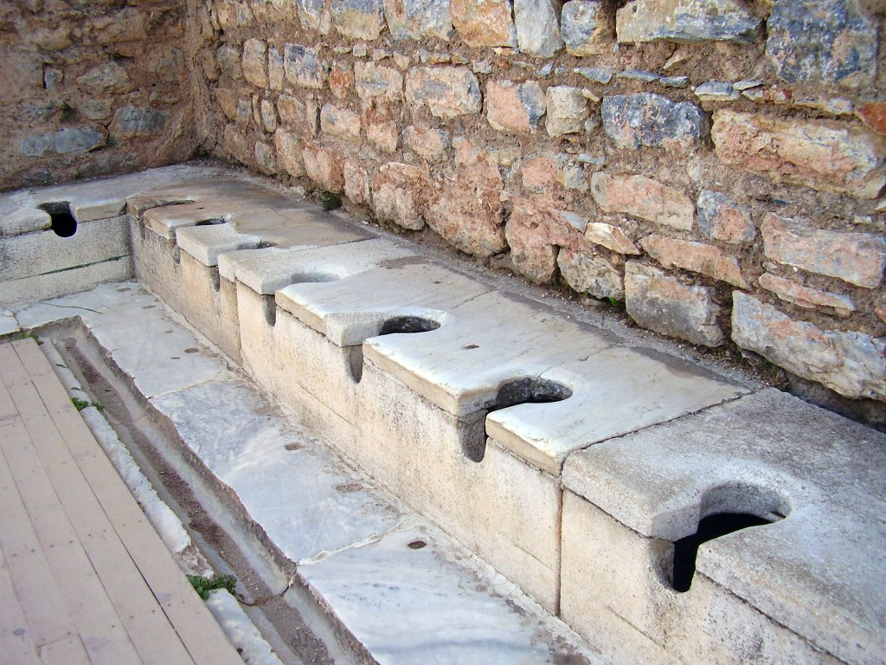
LATRINA

Slide 12
INSULA

Slide 13
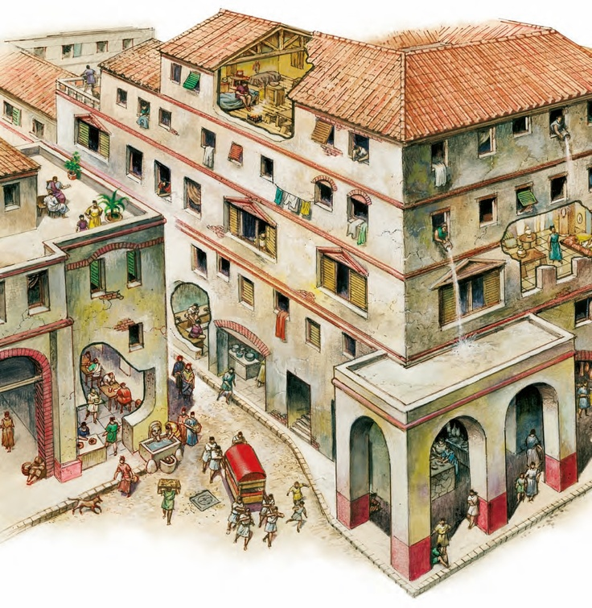

Slide 14
VILLA RUSTICA

Slide 16
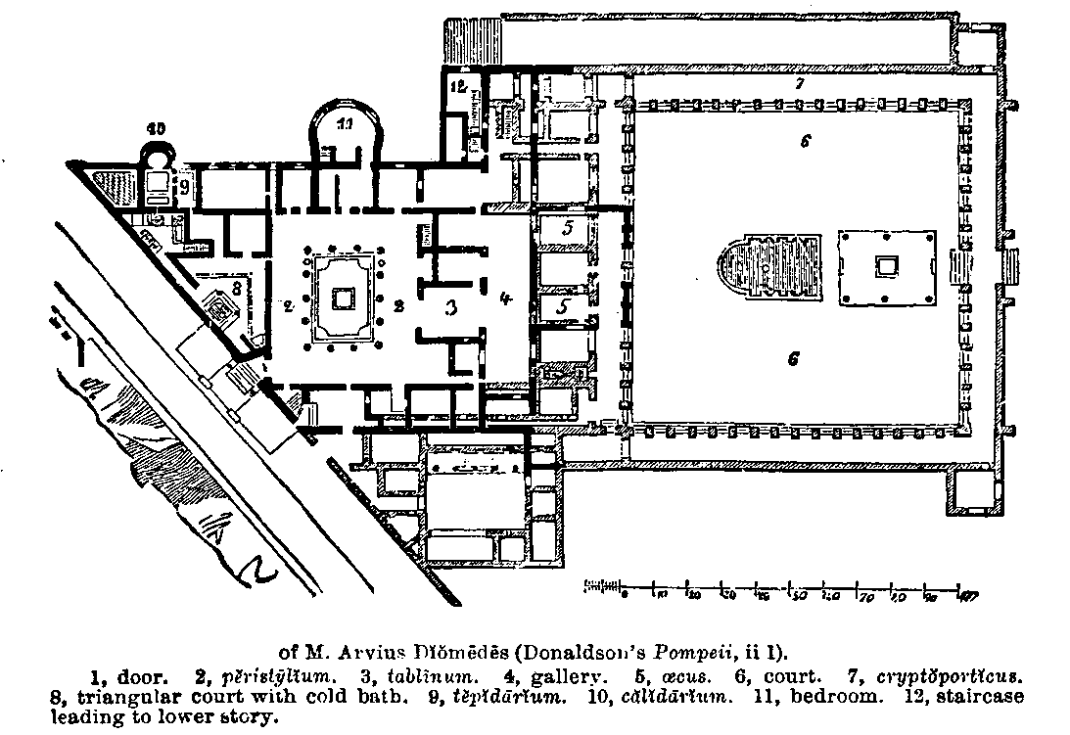
VILLA SUBURBANA

